Slide 1
Career Prep and Certifications
Cybersecurity
Lesson 23.1

Slide 2

Learning Objectives
By the end of today’s class, you will be able to:
1
Understand the importance of career and job-search preparation.
2
Understand the value of certifications in your job searches and career development.
3
Map certification road maps based on your specific experience level and field of interest.
4
Use CompTIA's CertMaster tool to begin preparing for the Security+ exam.
5
Understand performance-based questions (PBQs) and how to answer them.

Slide 4

Career Prep Week
Preparing for a New Career in Cybersecurity
Over the past several weeks, we've covered many different career paths and opportunities within cyber.
As the demand for cybersecurity professionals grows, employers want qualified individuals to fill an increasing number of roles.

Slide 5
This Week
Day 1
Day 2
We’ll cover certifications, with a focus on Security+, and some strategies for taking certification tests.
We will focus on mock interviews.
Notes:
#3 Instructor Do
The term digital marketing wasn’t even used before the 1990s (source). Personal computers started becoming popular in the 1980s, but the advent of the internet in the 1990s is what pivoted the direction of marketing. Even into the early 2000s, marketers largely relied on traditional channels to promote their wares.

Slide 6

An important first step to landing a job or furthering your career is to demonstrate that you can do the tasks your job requires.
One good way to do this is with a certification exam .
Notes:
shutterstock_437918524

Slide 7

Certifications by the Numbers
As of April 2020…
44
300
25
organizations
issue over
cybersecurity certifications for
specializations
and paths.

Slide 8


This Week
We’ll also dive deeper into Security+.
This course comes with a voucher for the Security+ exam, so we’ll spend the most time on this certification.
We’ll cover:
Test preparation tips
The CompTIA CertMaster study tool
PBQs
Domains on the exam not
covered in this course’s curriculum

Slide 9
Information Security Certifications

Slide 10






InfoSec Certifications
Certifications can give you an advantage when applying for your first cybersecurity job, and they provide the following benefits:
01
02
03
Further Education
Networking
Career Advancement
Notes:
Stock-photo-a-prospective-student-is-pondering-over-the-advantages-of-education-a-concept-of-the-further-280809086
Stock-photo-group-of-mature-students-collaborating-on-project-in-library-284521556
Stock-photo-development-career-growth-success-and-progress-concept-1815254963

Slide 11

InfoSec Certifications
01
Education
You learn new skills while preparing for a certification, even before the certification is formally awarded. While achieving credentials is often the objective, the material learned while studying for the exam is also valuable to job performance.

Slide 12

InfoSec Certifications
02
Networking
Many certifications have national and local organizations that host meetings, conferences, seminars, and social events. These can be opportunities to network with peers.

Slide 13

InfoSec Certifications
03
Career advancement
Certifications put more established professionals in a stronger position to get a promotion.

Slide 14
Cybersecurity professionals may pursue different types of certificates depending upon the stage of their career.

Slide 15
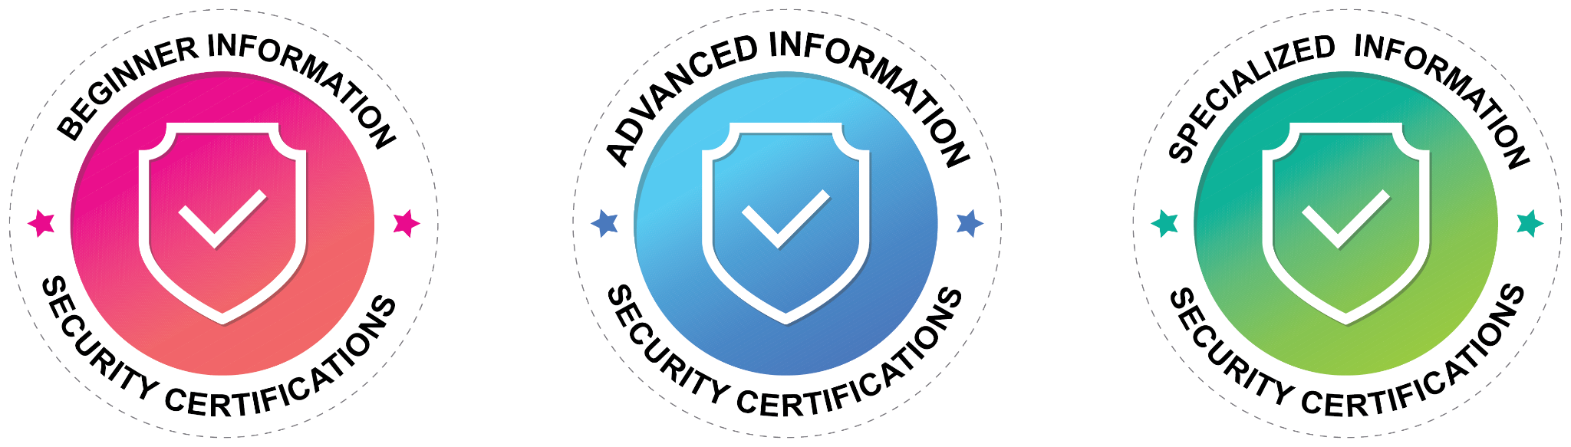
Types of InfoSec Certifications
We can break certifications into three categories:
Beginner InfoSec Certifications
These are the first certifications individuals new to the field should obtain.
Advanced InfoSec Certifications
These should be obtained after working in the industry for several years.
Specialized InfoSec Certifications
These focus on a specific domain and should be obtained after working in the industry for several years.

Slide 16
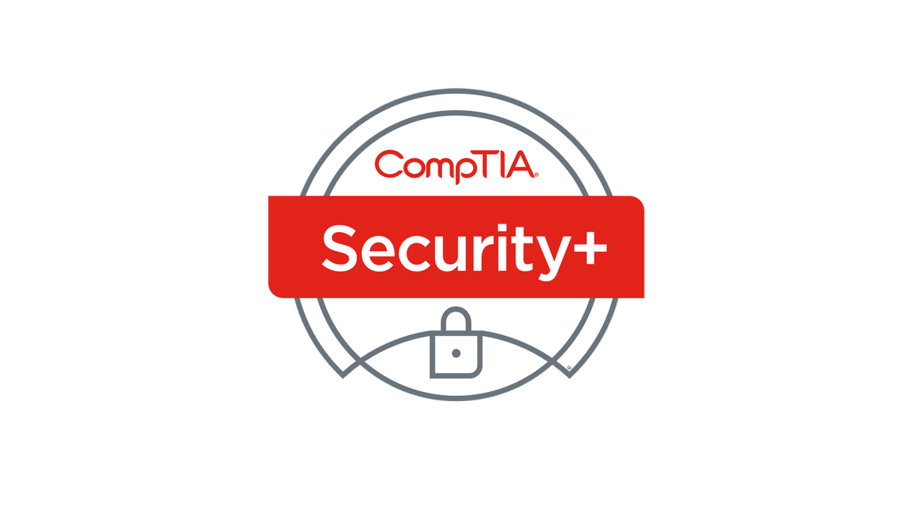
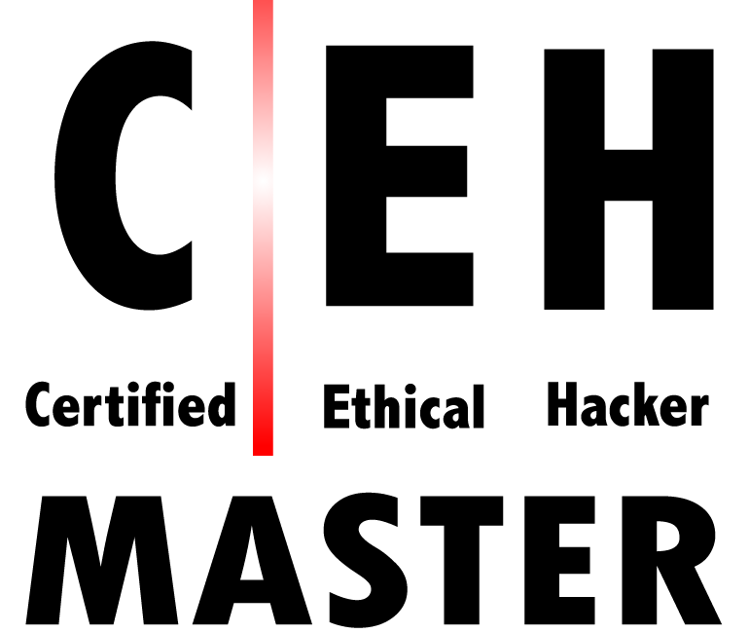

Beginner Certifications
Entry level and foundational towards more advanced certificates
These certifications typically do not have minimum work requirements or prerequisite courses.
They typically cover a broad range of subjects.

Slide 17
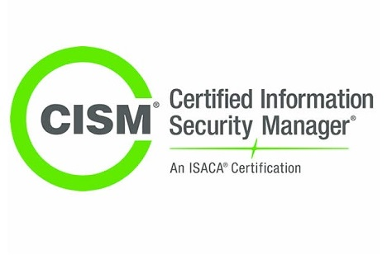
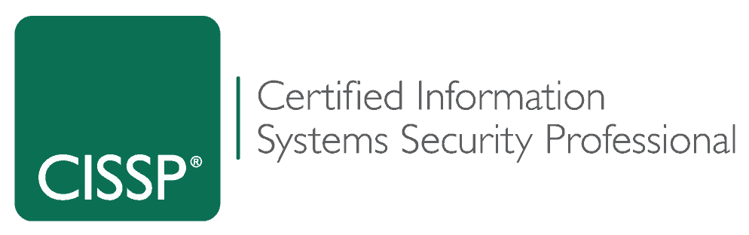
Advanced Certifications
Many of these certifications focus on security management.
These certifications typically have minimum work requirements and prerequisite courses.
They typically cover a broad range of subjects.

Slide 18
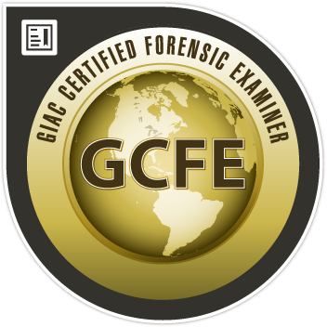
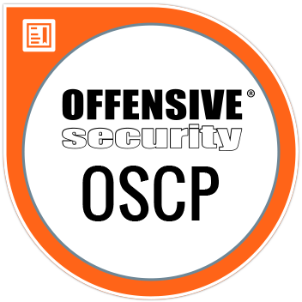

Specialized Certifications
Security professionals obtain these after working in the industry for several years.
These certifications typically have minimum work requirements and prerequisite courses.
Cover specific subjects and can be vendor or non-vendor specific.

Slide 19


Certification Pathways
Penetration testers
may follow this path:
Forensic investigators
may follow this path:
OSCP
EnCE
CISSP
GCFA
CEH
CFCE
Security+
Note: We’ll cover these additional certifications in more detail later in the lesson.

Slide 20
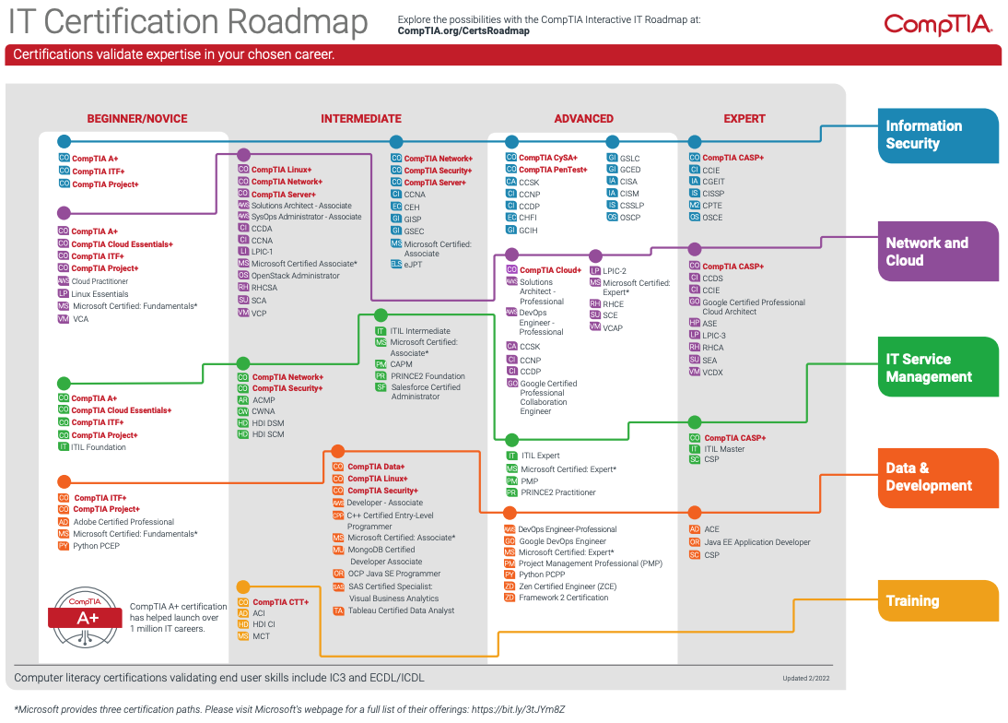

Slide 21

Certifications and Careers
In the next activity, you will use job search websites to research InfoSec careers and certifications.
You are tasked with finding five information security careers and the desired or required certifications that align with each.
You will add your findings to the spreadsheet provided.
20 Minutes

Slide 24

Certification Pathways

Slide 25

Beginner Certifications
While Security+ will likely be the first certification you’ll work toward, several other beginner InfoSec certifications don’t require experience and cover many domain areas.

Slide 26
Certification Pathways
Beginner: Certified Ethical Hacker (CEH)
Offered by EC Council
Focuses on penetration testing
Includes a range of topics for InfoSec professionals
Offers an advanced version: CEH Practical
  Hands-on environment

Slide 27
Certification Pathways
Beginner: GIAC Security Essentials (GSEC)
Offered by Global Information Assurance Certification (GIAC)
Covers a broad spectrum of topics ranging from active defense to cryptography

Slide 28

Certification Pathways
Beginner: Systems Security Certified Professional (SSCP)
Offered by ISC2
SSCP covers security best practices for setting up, monitoring, and administering IT infrastructure.
While SSCP is one of the entry-level certifications offered by ISC2, it does request one year of professional cybersecurity experience.

Slide 29

Many cyber professionals advance their careers by obtaining advanced and specialized certifications.
Notes:
shutterstock_1023890479

Slide 30
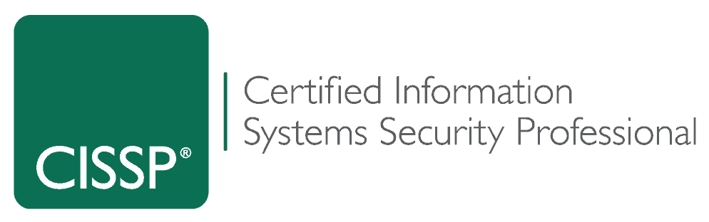
Certification Pathways
Advanced: Certified Information Systems Security Professional (CISSP)
Offered by ISC2
It covers a wide variety of cybersecurity topics and is one of the most popular certifications in information security.

Slide 31
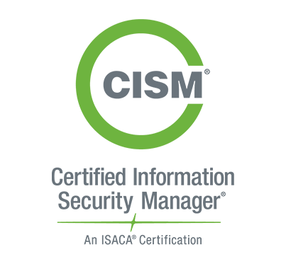
Certification Pathways
Advanced: Certified Information Security Manager (CISM)
Offered by ISACA
It covers information security management topics.

Slide 32

Specialized Certifications
There are hundreds of specialized certifications for those interested in mastering a specific cybersecurity domain.

Slide 33

Certification Pathways
Specialized: Offensive Security Certified Pentester (OSCP)
Offered by Offensive Security
It is a hands-on penetration testing exam consisting of two parts: a 24-hour penetration testing exam and a documentation report due 24 hours after the exam.

Slide 34
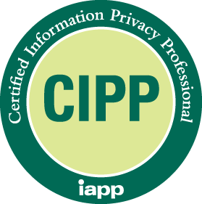
Certification Pathways
Specialized: Certified Information Privacy Professional (CIPP)
Offered by IAPP
It is considered the "gold standard" for those working in privacy.

Slide 35

Certification Pathways
Specialized: EnCase Certified Examiner (EnCE)
Offered by OpenText
Vendor-specific specialized certification for computer forensics professionals
Used by law enforcement

Slide 36
Find a Certification Pathway
In this activity, you will research several advanced and specialized certifications.
20 Minutes

Slide 40
Introduction to Security+

Slide 41
What is the Security+ certification?

Slide 42
“Security+ is the first security certification IT professionals should earn.”
“It establishes the core knowledge required of any cybersecurity role and provides a springboard to intermediate-level cybersecurity jobs.“
“Security+ incorporates best practices in hands-on troubleshooting to ensure security professionals have practical security problem-solving skills.“
“Cybersecurity professionals with Security+ know how to address security incidents—not just identify them.”
CompTIA

Slide 43
Introduction to Security+ Certification
Some jobs that may require the Security+ certification:
Security Architect
Security Engineer
Security Consultant
Security Specialist
InfoSec Analyst

Slide 44
Introduction to Security+ Certification
What domains does Security+ cover?
Attacks, Threats, and Vulnerabilities
Architecture and Design
Implementation
Operations and Incident Response
Governance, Risk, and Compliance

Slide 45
Introduction to Security+ Certification
Security+ is obtained by passing the CompTIA-administered Security+ exam.
There are 90 multiple-choice and performance-based questions.
The exam lasts 90 minutes.
The cost of the exam is $392.
The exam is vendor-neutral.

Slide 46

While there are many books, online resources, study guides, and apps to help prepare for the exam, CompTIA provides the most up-to-date resources for exam prep.
Preparation Tips
Focus
on your
weak spots.
Organize your study time.
Use supplemental study
tools.
Use
CompTIA study
tools.
Find a Security+ online community.

Slide 47

Design a structured study plan and stick with it. Block out at least several weeks to study for the exam.
Preparation Tips
Focus
on your
weak spots.
Organize your study time.
Use supplemental study
tools.
Use
CompTIA study
tools.
Find a Security+ online community.

Slide 48

Early on, attempt to determine which domains are the most challenging, and focus your studies there.
Preparation Tips
Focus
on your
weak spots.
Organize your study time.
Use supplemental study
tools.
Use
CompTIA study
tools.
Find a Security+ online community.

Slide 49

Create study guides and flashcards of common terms and acronyms. Find video content that explains confusing subjects.
Preparation Tips
Focus
on your
weak spots.
Organize your study time.
Use supplemental study
tools.
Use
CompTIA study
tools.
Find a Security+ online community.

Slide 50

Many blogs, forums (e.g., Reddit), and wiki pages are dedicated to preparing for the exam.
Preparation Tips
Focus
on your
weak spots.
Organize your study time.
Use supplemental study
tools.
Use
CompTIA study
tools.
Find a Security+ online community.

Slide 51
Test-Taking Tips
Take care of yourself.
Pay attention.
If you’re unsure of
an answer, guess.
Arrive early, well-rested, fed, hydrated, and relaxed.
Read each question and answer option twice before deciding on your answer.
Look for keywords in the questions, such as “best,” “most,” or “least.”
Always stay aware of how much time remains.
Eliminate the answers you know are wrong, and select from the remaining answer options.
You’ll receive the same penalty for an incorrect answer as for an unanswered question, so always make a best guess.

Slide 52
Security+ CertMaster

Slide 53
Security+ CertMaster
You’ll be provided with access to the CertMaster Practice tool. This comes with:
Quick knowledge assessment
Adaptive learning that reinforces existing and new knowledge
Personalized feedback
Real-time learning analytics

Slide 54
Security+ CertMaster

Slide 55
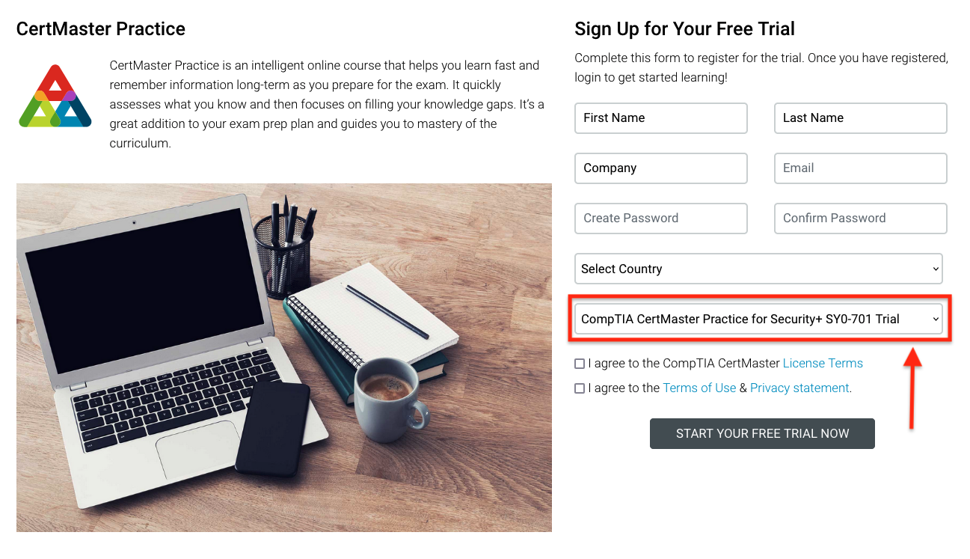
Go to https://www.comptia.org/training/certmaster-practice/security
Begin Setting Up the Free Trial
Notes:
shutterstock_662660182

Slide 56
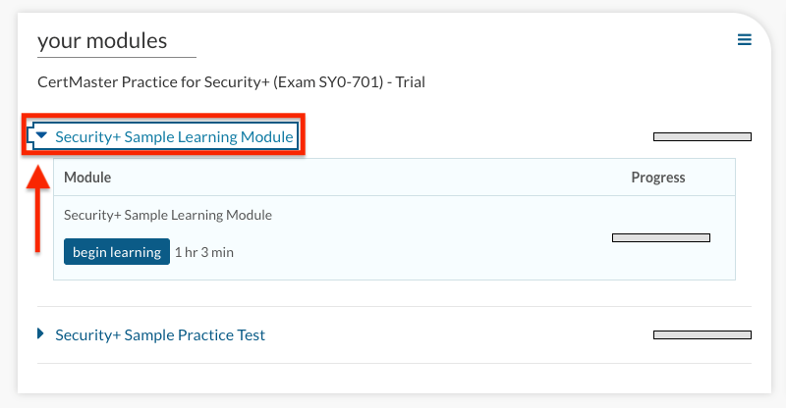
The free trial only has one module. The full CertMaster Tool will cover all domains of the exam.
Review the Learning Module
Notes:
shutterstock_662660182

Slide 57
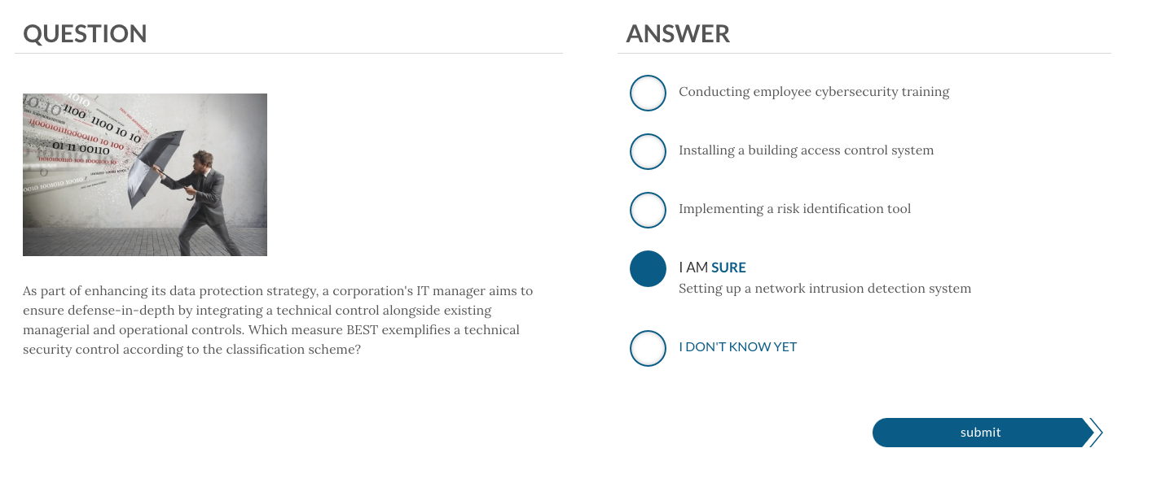
Click an answer twice to fill in the circle if you’re certain it is the correct answer.
Answering Questions
Notes:
shutterstock_662660182

Slide 58
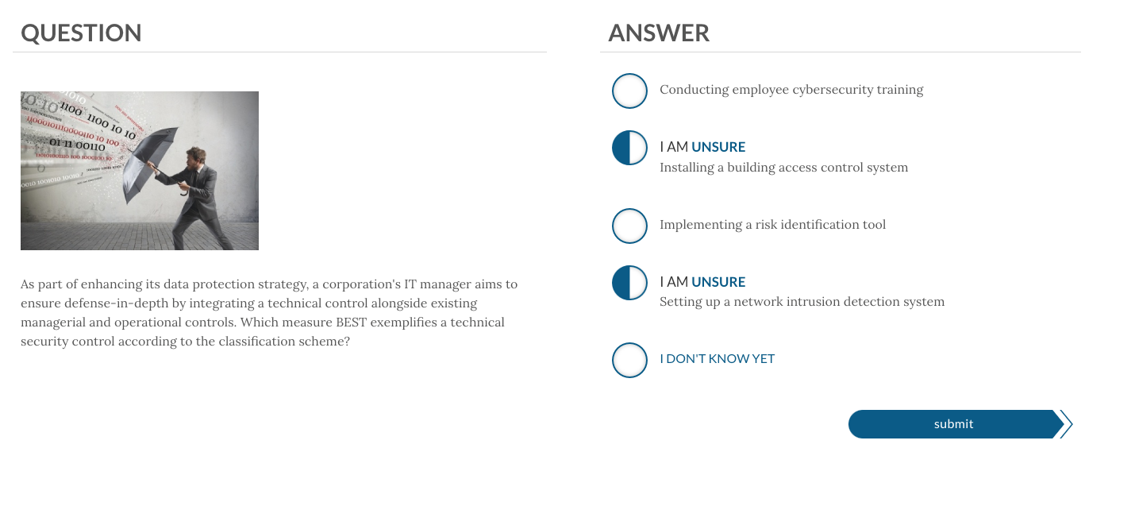
If you are unsure of the answer, you can click multiple answers once.
Answering Questions
Notes:
shutterstock_662660182

Slide 59
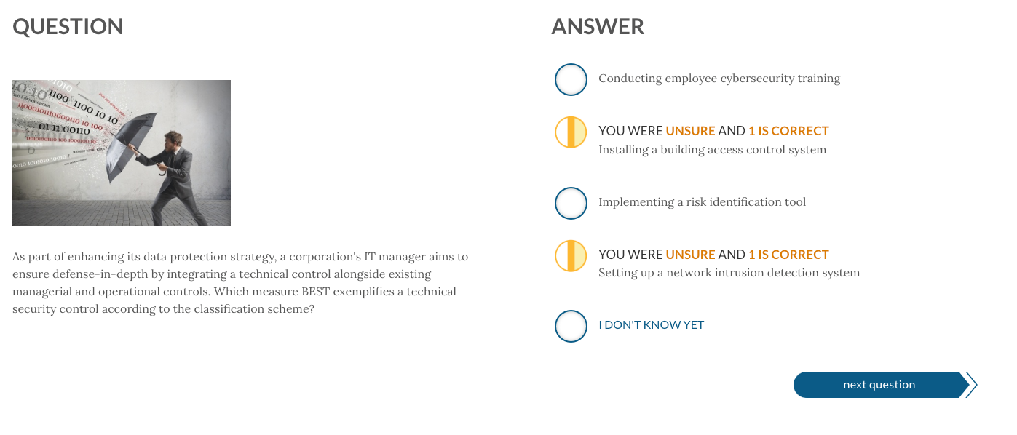
The tool will let you know if any of your answers are correct.
Submitting Answers
Notes:
shutterstock_662660182

Slide 60
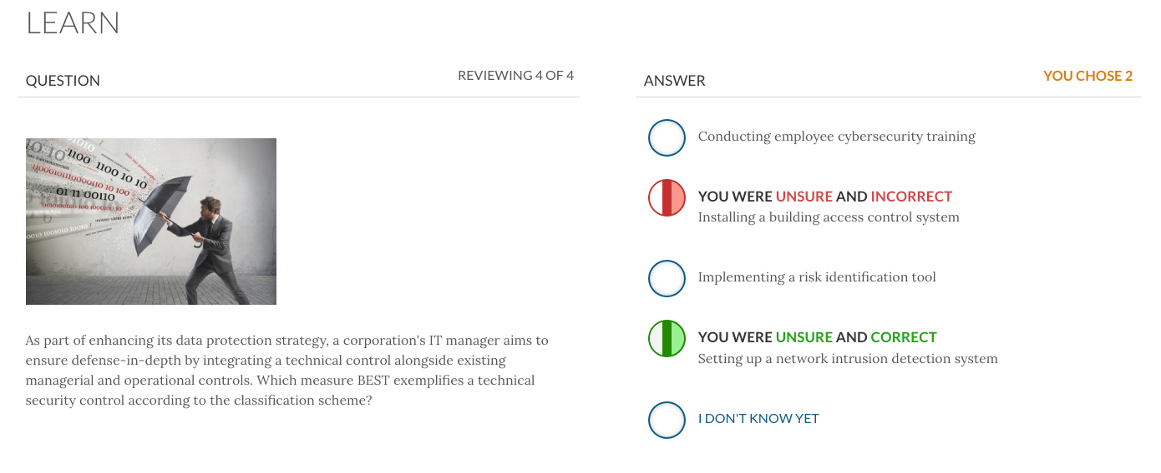
The tool will let you know which answer is correct.
Reviewing Answers
Notes:
shutterstock_662660182

Slide 61
The tool will let you know which answer is correct.
Reviewing Answers
Notes:
shutterstock_662660182

Slide 62
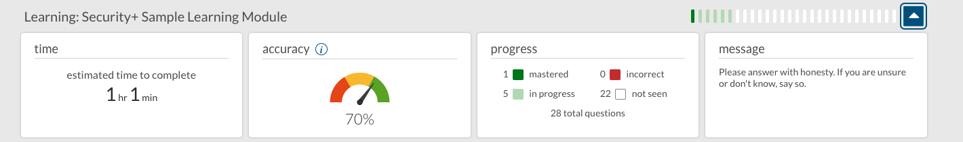
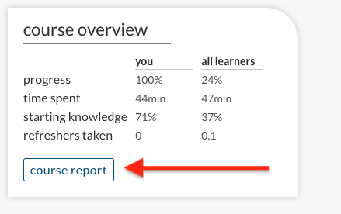
While you are working on a module, you can view your current progress by clicking the arrow on the top right of your module.
After you complete the module, you can view a summary of the completed modules.
From the dashboard, select Course Report.
Additional Tips
Notes:
shutterstock_662660182

Slide 63
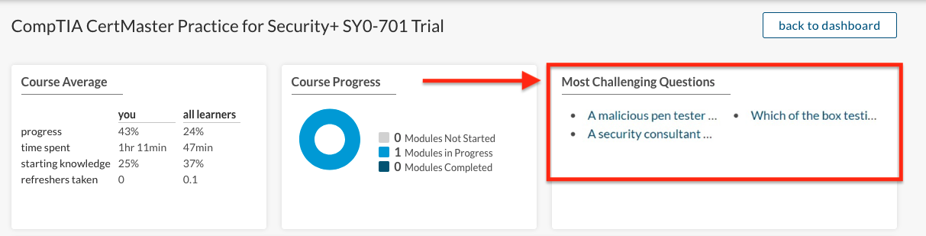
Additionally, the Course Report page shows the most challenging questions, which you can return to and re-answer
Additional Tips
Notes:
shutterstock_662660182

Slide 64
Security+ CertMaster
In this activity, you will use the Security+ CertMaster study trial to complete the sample test module.
10 Minutes

Slide 67
Security+ PBQs

Slide 68
Security+ PBQs
The Security+ exam has two types of questions: multiple choice and performance-based questions (PBQs).
PBQs present a simulated environment, such as a network, firewall, or terminal.
Since the question environment is simulated and not live, there may be some limitations compared to a real-world environment.
PBQs are often the first questions on the Security+ exam.

Slide 69
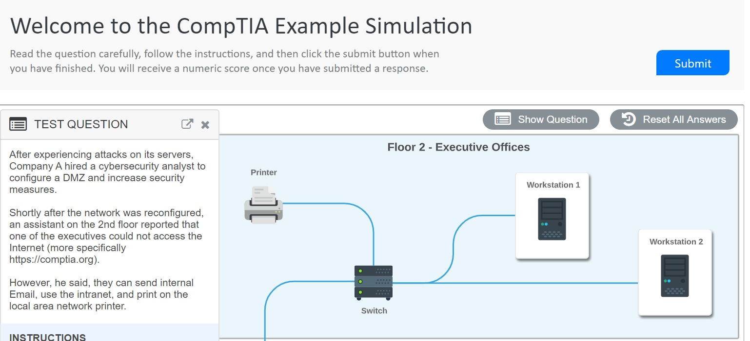
Let’s explore Security+ PBQ questions.
PBQs
https://simulation.comptia.org/

Slide 70
Security+ PBQs

Slide 71
Security+ PBQs
In this activity, you will work through several Security+ PBQs.
You are tasked with completing all of the questions in the allotted time.
Be sure to read all the instructions carefully before completing the activity.
15 Minutes

Slide 74
Security+ PBQs

Slide 76
Module Recap
We’ve examined a lot of information and done the following:
Performed mobile forensic analysis and compiled details of Peter’s iPhone
Searched through numerous files and directories on the iPhone image
Tagged and categorized evidence relevant to the case
Created custom tags

Slide 77
Module Recap
We’ve examined a lot of information and done the following:
Extracted data for offline analysis using the export function
Examined and documented Peter’s emails
Examined and documented Peter’s SMS messages

Slide 78
Class Wrap-Up
Key takeaways from this lesson:
Digital forensics
is a field dedicated
to identifying, extracting, preserving, and reporting against information obtained from computer and network systems.
Digital forensics relies upon the expertise
of examiners to analyze and interpret data retrieved by trusted forensics examination tools.
Investigative teams may be spread across several times zones,
so it's important to follow a baseline timezone as indicated by case file.

Slide 79
You’ll continue your report and work on another bonus assignment for this week’s Challenge.

Slide 81
Cybersecurity Interviewing

